Slide 1
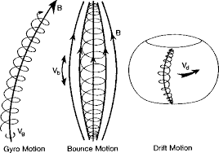
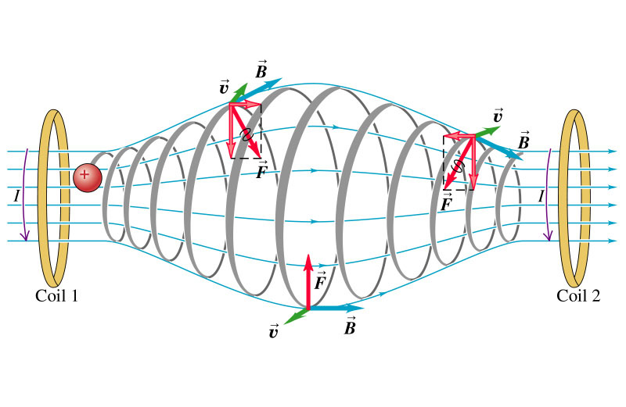
(a)
(b)
Gyro Motion Bounce Motion Drift Motion
$$F=q(v×B+E)$$

Slide 2
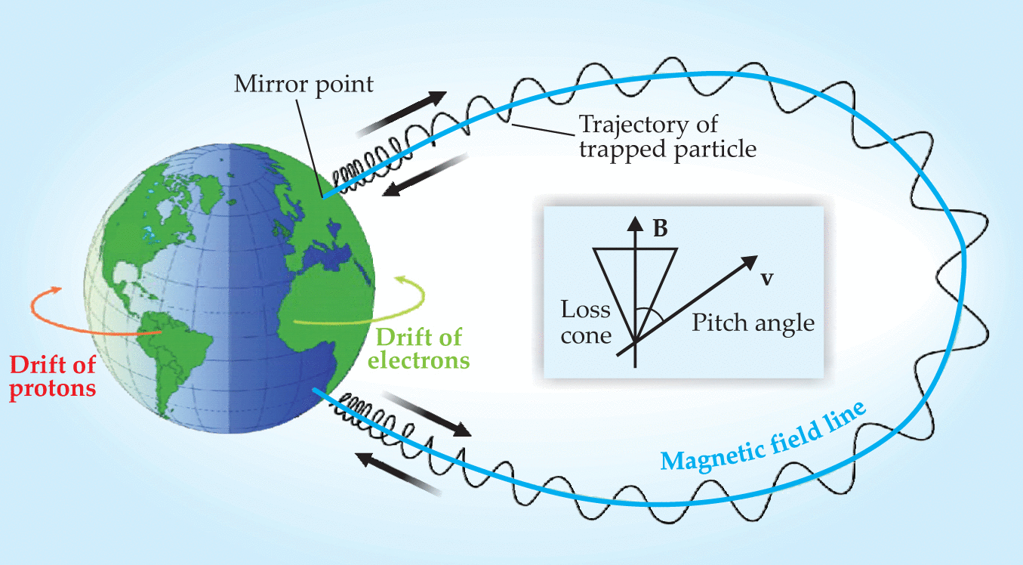

Slide 3
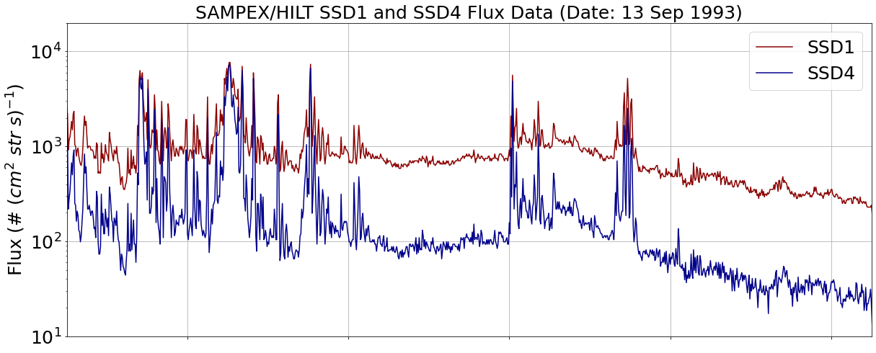
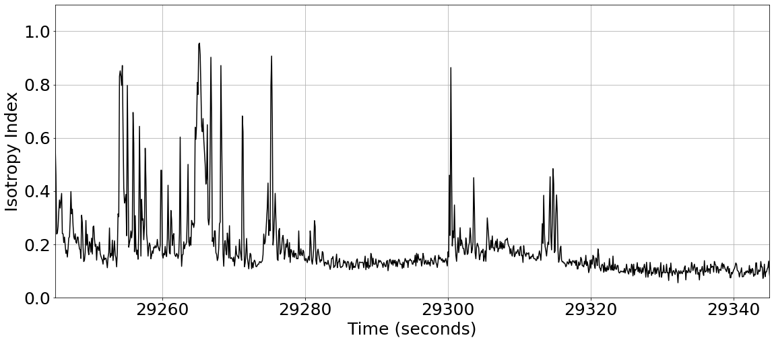
(a) SSD1 and SSD4 Electron Flux vs Time
(b) Isotropy Index vs Time

Slide 4
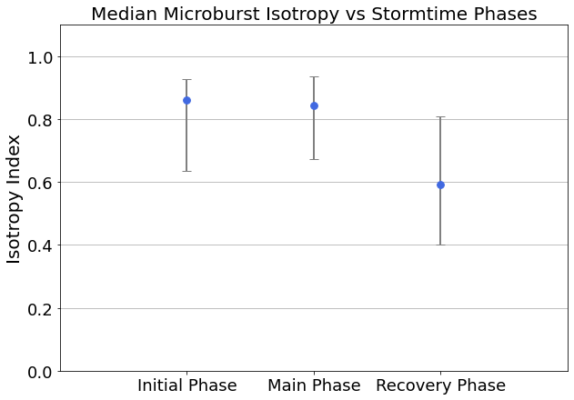
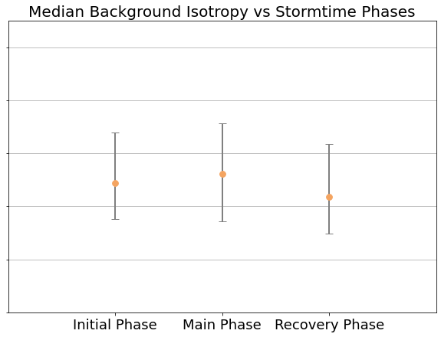
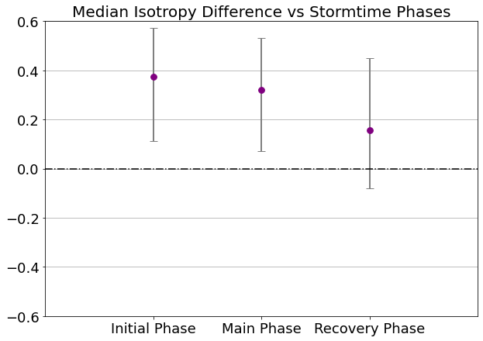
(a)
(b)
(c)

Slide 5
